Slide 1



Determining the disruption of the Little Colorado River by past eruptions of the San Francisco Volcanic Field
Amanda Ketting-Olivier
Mentor: Dr. Nancy Riggs
Institute: Northern Arizona University

Slide 2
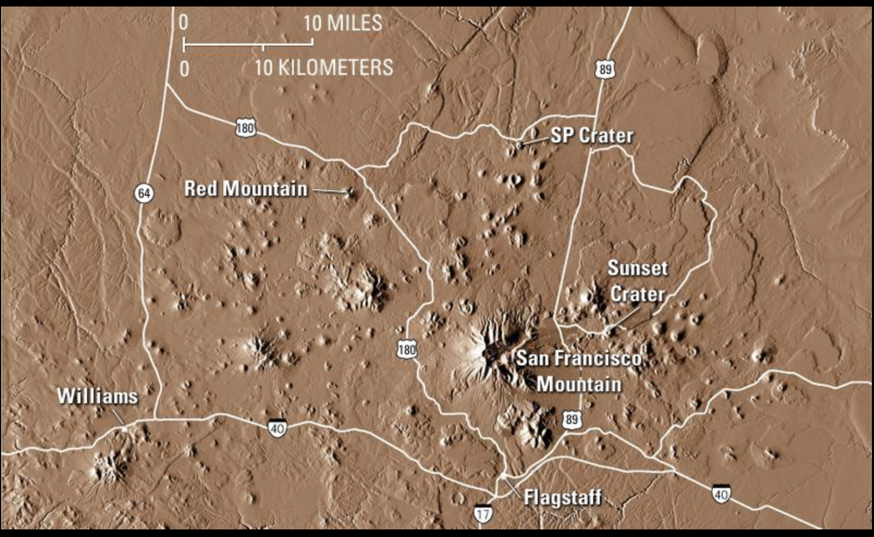
Study Area
San Francisco Volcanic Field (SFVF)
~600 volcanic vents
  6 Ma to 900 ybp

Slide 3
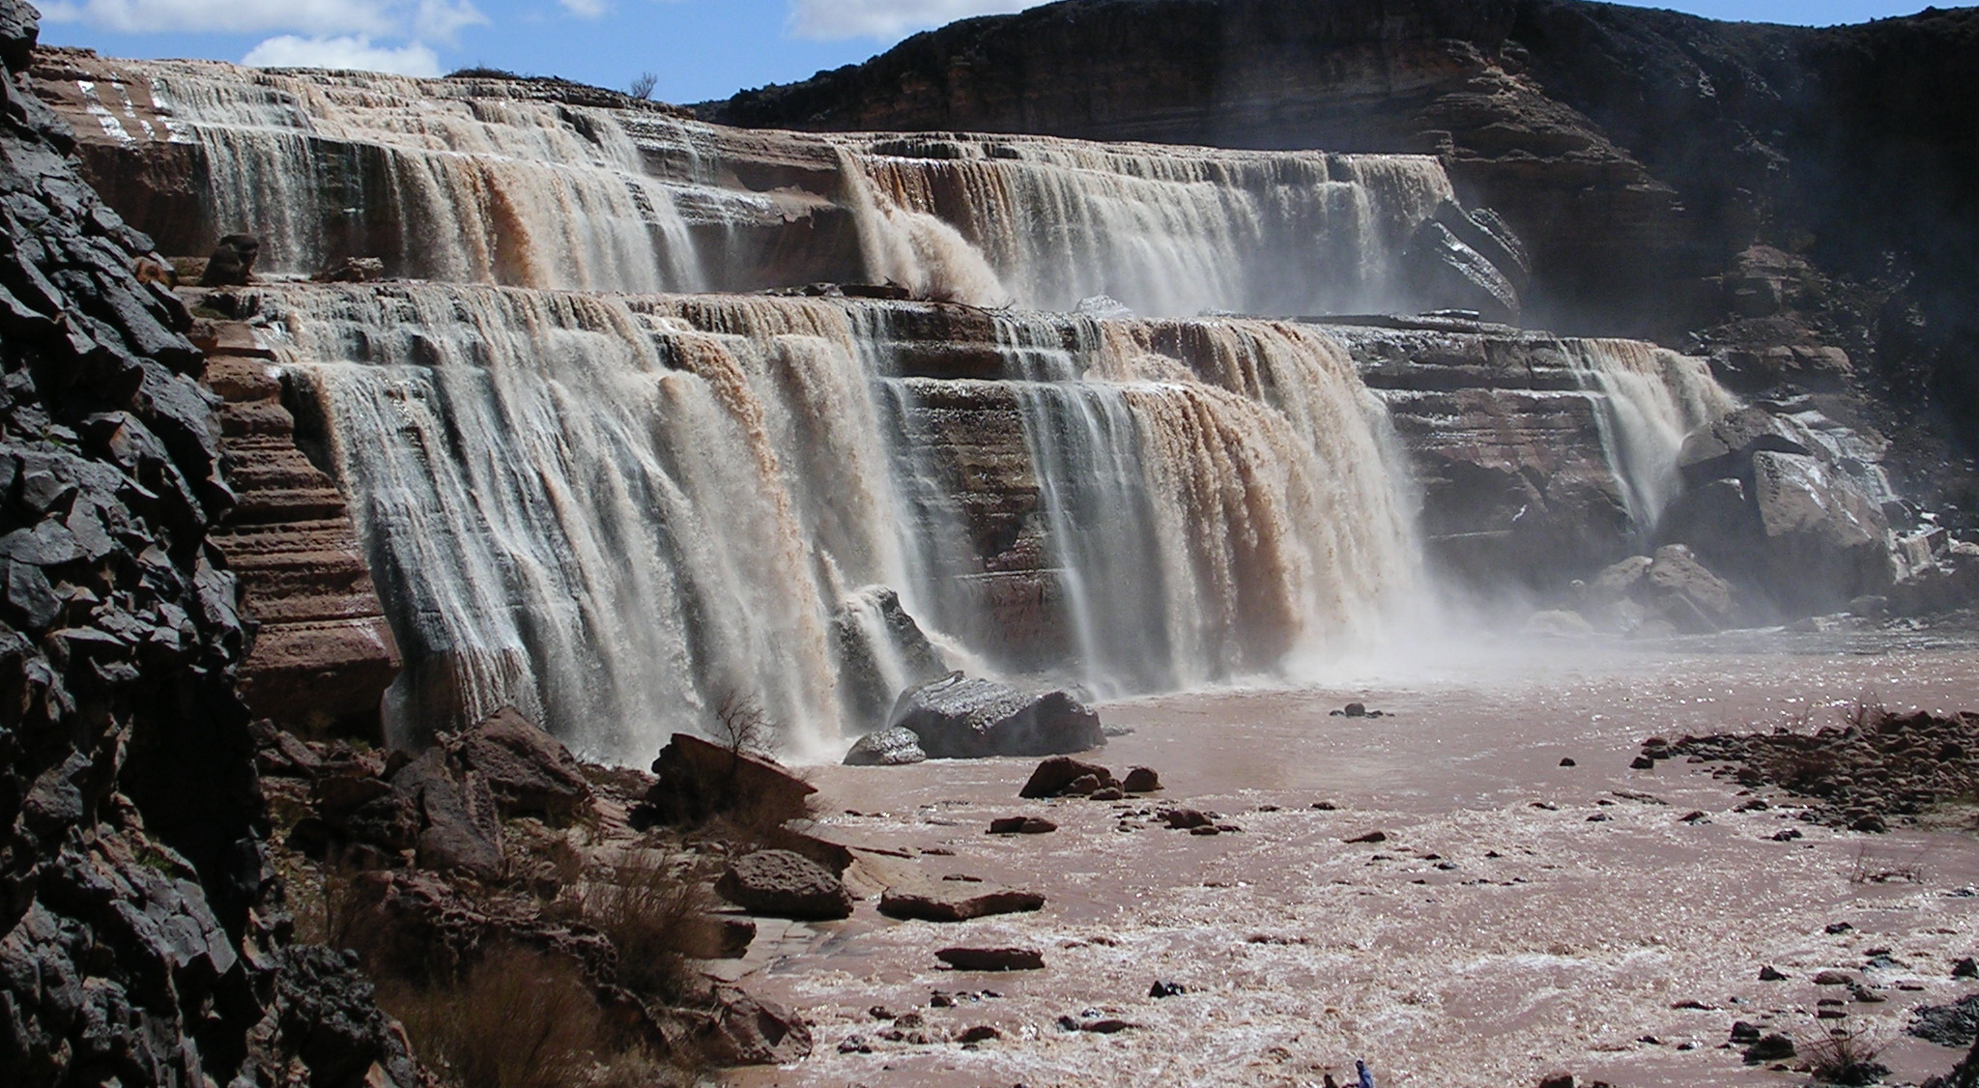
Grand Falls

Slide 4
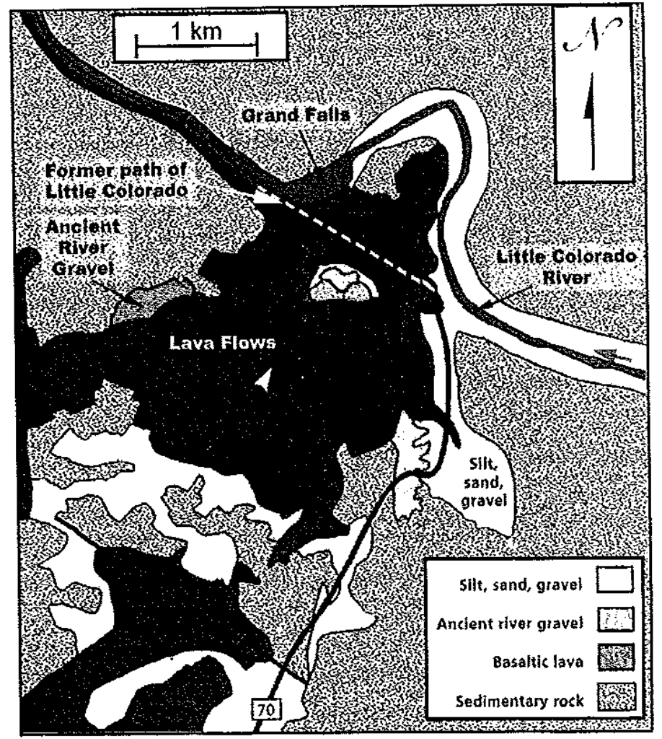
Former path of Little Colorado River (LCR)
Disruption of river channel
  Flow in channel
  20 ka (Duffield et al., 2006)
  Caused divergence
(Hanson et al., 2008)

Slide 5
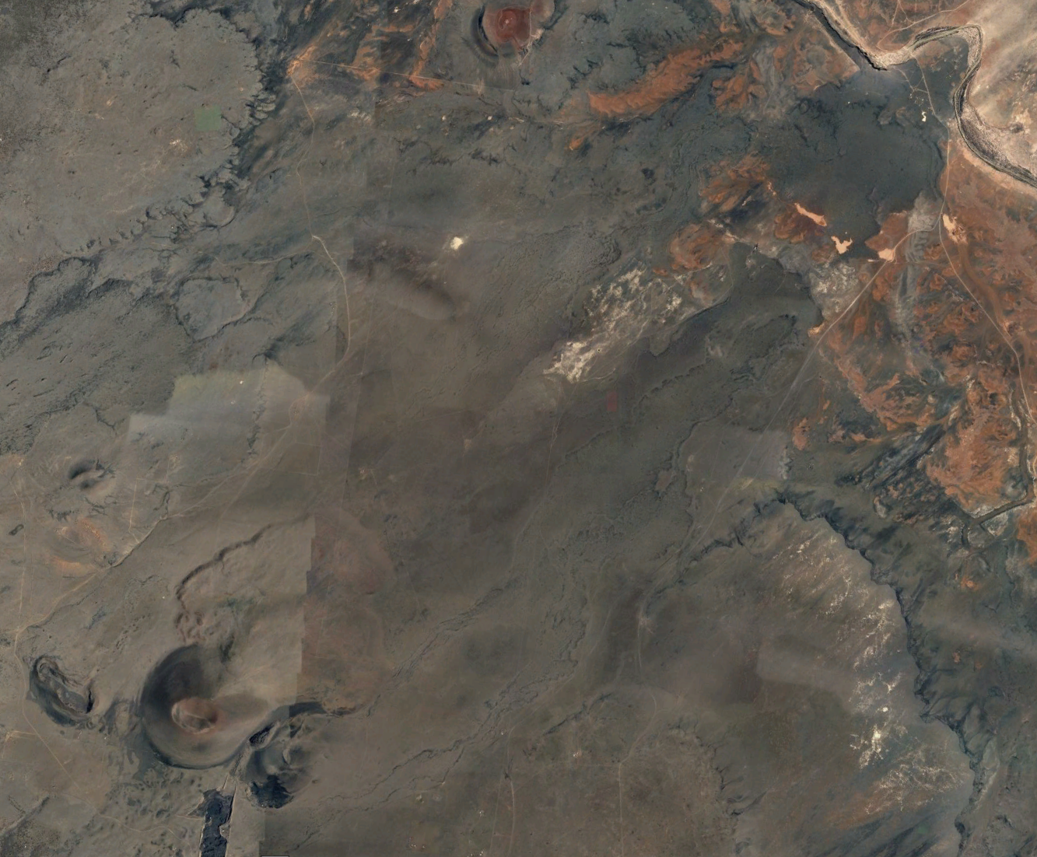
Grand Falls
Location of the potential vents
Sample locations
Moenkopi bedrock
The Sproul
Merriam Crater

Slide 6
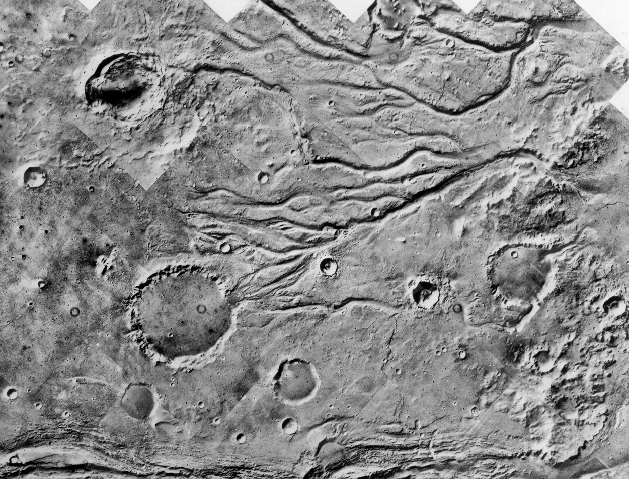
Importance
Look at similar features of disruptions along river channels on other planets
  Exploration of Mars
  Use of geochemistry and other methods

Slide 7
Methods
Difficult to follow flow

Slide 8
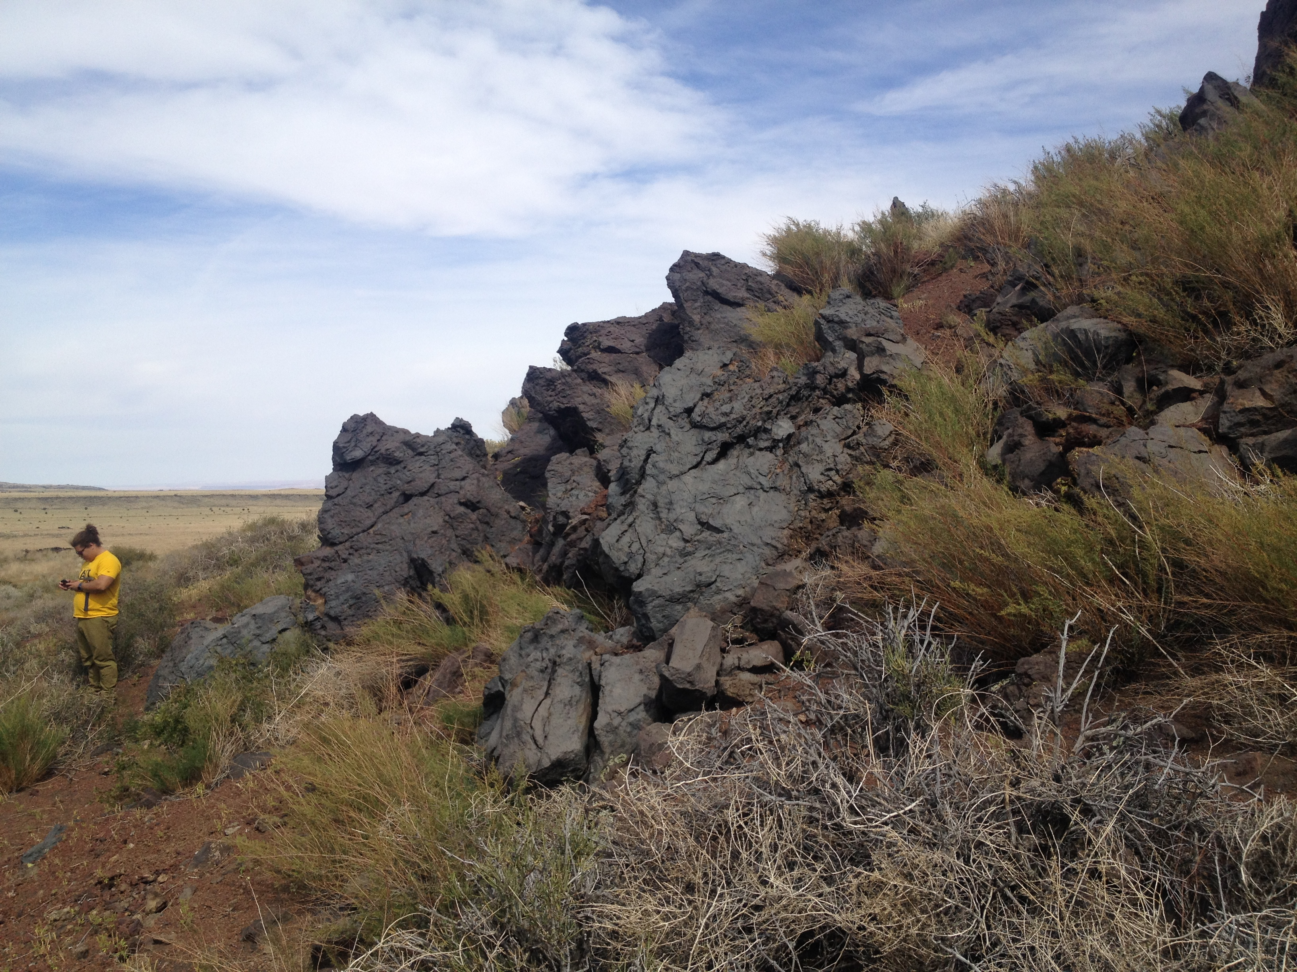
Methods
Reconnaissance of the area
  Changes in flow throughout area
    Many flows overlap

Slide 9
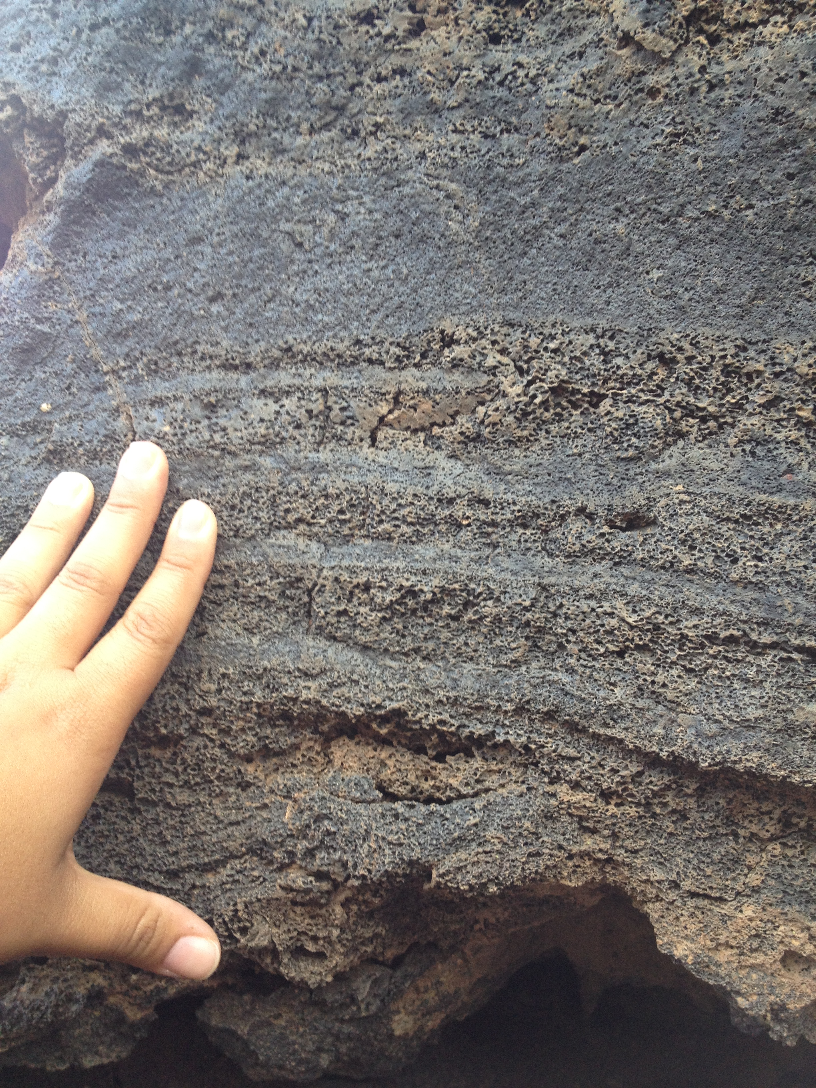
Methods
Samples collected
  Rock samples rough collected
  Thin section will give mineral composition
  Geochemical analysis will give major and trace elements

Slide 10
Analysis
Not completed: samples not back
Results expected in the coming weeks
  Thin section- compare matrix vs. minerals
  Geochemistry- compare major and trace elements
        Na₂O
        K₂O
        MgO

Slide 11
Conclusion
Source of the flow that disrupted the Little Colorado River

Slide 12
Acknowledgements
Dr. Nancy Riggs, mentor
Northern Arizona NASA Space Grant

Slide 13
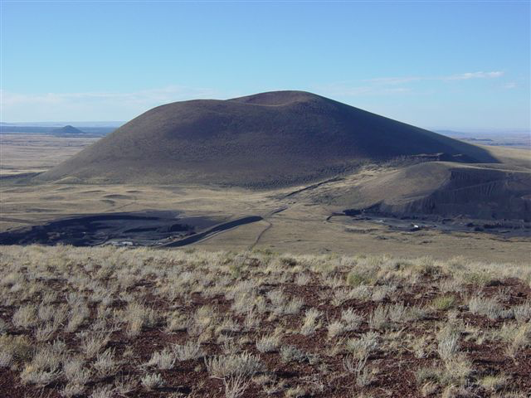
Any Questions?

